Slide 1
Home Credit Default Risk
Imogen Holdsworth - Madalyn Young - Tyler Swanson
Notes:
Thank you for joining us for our presentation on enhancing Home Credit's predictive capabilities to address their business challenge of identifying and mitigating default risk while empowering their clients.
Death By Powerpoint Notes
1. Focus on One Idea Each slide should convey just one message to maintain clarity.
2. Keep It Concise & Visual Use brief text with supporting images. Avoid full sentences—let visuals enhance your point.
3. Highlight What Matters Make the most crucial content larger to catch the audience’s eye.
4. Use Contrast Effectively Contrast directs attention. Dark backgrounds can make key text pop.
5. Limit to 6 Elements Avoid clutter—keep each slide simple with no more than 6 elements.

Slide 2

The Business Problem
Inability to Access Loans
Financial Challenges
Vulnerability to Predatory Lenders
Wrongful Rejections
Notes:
Accessing loans is a challenge for many individuals, particularly those with limited or no credit history. This leads to financial hardships, vulnerability to predatory lenders, and wrongful rejections. Working with Home Credit Group, our goal is to solve these issues by utilizing data to create a safe and fair borrowing experience for clients with non-traditional credit histories.
Business Problem: People often have a difficult time when it comes to getting loans due to a lack of credit history. This can lead to financial challenges and even result in loans being placed with unethical lenders. Home Credit Group is looking to solve this issue by providing a positive and safe borrowing experience to people that lack traditional credit history. One of Home Credit’s challenges is unlocking the full potential of their data to ensure their current system for predicting who can repay loans is accurate. Currently, some customers that should qualify for a loan are being wrongly rejected due to limitations in Home Credit Group’s system.
Inability to Access Loans: Many individuals face barriers to obtaining loans due to systemic limitations.
Financial Challenges: Restricted access to credit exacerbates economic hardships.
Vulnerability to Predatory Lenders: Limited options may lead clients to rely on exploitative lending practices.
Wrongful Rejections: Outdated systems wrongly reject eligible borrowers.

Slide 3

Benefit of a Solution
Ethical Lending Options
Client Empowerment
More Loans and Fewer Defaults
Notes:
A more accurate prediction system will benefit both clients and lenders. For clients, it means ethical lending options, financial empowerment, and better opportunities. For lenders, it ensures increased loan approvals, fewer defaults, and stronger client relationships.
Benefit of a solution: If Home Credit Group can enhance their prediction system to more accurately assess a customer’s ability to repay loans, they will be able to offer ethical lending options to those in need. Unlocking the full potential of their data will also ensure that the loan terms and conditions they provide will empower their clients to be successful.
Ethical Lending Options: Provide fair and accessible financial opportunities.
Client Empowerment: Enable financial independence and stability.
More Loans and Fewer Defaults: Improve access while minimizing risk.

Slide 4

Objectives for Improvement
Improved Predictive Modeling
Enhancing Model Specificity
Compare Various Models
Feature Engineering
Notes:
To achieve these goals, we’ve developed predictive models that:
Improve our ability to accurately identify creditworthiness.
Reduce false rejections through enhanced model specificity.
And Leverage advanced techniques like feature engineering to improve performance.
Improved Predictive Modeling: Develop robust models to identify creditworthiness.
Enhance Specificity: Reduce false rejections.
Model Comparisons: Evaluate and optimize algorithms.
Feature Engineering: Extract meaningful insights from data.
Class Balancing: Address the imbalance between default and non-default cases.

Slide 5
Strategic Approach
Dataset Preparation & Baseline Models
Model Development & Refinement
Model Enhancement & Ensemble Techniques
Notes:
Our approach includes three phases:
dataset preparation
model development
model enhancement.
We believe this approach will enable us to strengthen and maximize the client-lender relationship fostered by Home Credit.
Dataset Preparation & Baseline Models:
Establish training and validation datasets.
Create baseline benchmarks with simple models.
Model Development & Refinement:
Implement Logistic Regression, Random Forest, GLM, and XGBoost.
Address class imbalance and data transformation challenges.
Model Enhancement & Ensemble Techniques:
Apply advanced feature engineering.
Combine models for superior performance.

Slide 6

Success Metrics
Key Indicators
Higher Approval Rates
Reduced Default Rates
Empowering Loan Terms
Model Metrics
Model Recall > Majority Classifier Model
Model AUC > Baseline AUC
Notes:
Success will be measured by:
Achieving model performance metrics that exceed baseline benchmarks for accuracy and AUC, this will
Increased approval rates for creditworthy clients.
Reduced default rates through accurate predictions.
And Provide loan terms that empower clients to succeed.
Key Indicators:
Higher Approval Rates: Increase access for creditworthy clients.
Reduced Default Rates: Minimize financial risks.
Empowering Loan Terms: Provide clients with flexible, achievable repayment options.
Model Metrics:
Accuracy > Majority Classifier.
AUC > Baseline (0.5).

Slide 7
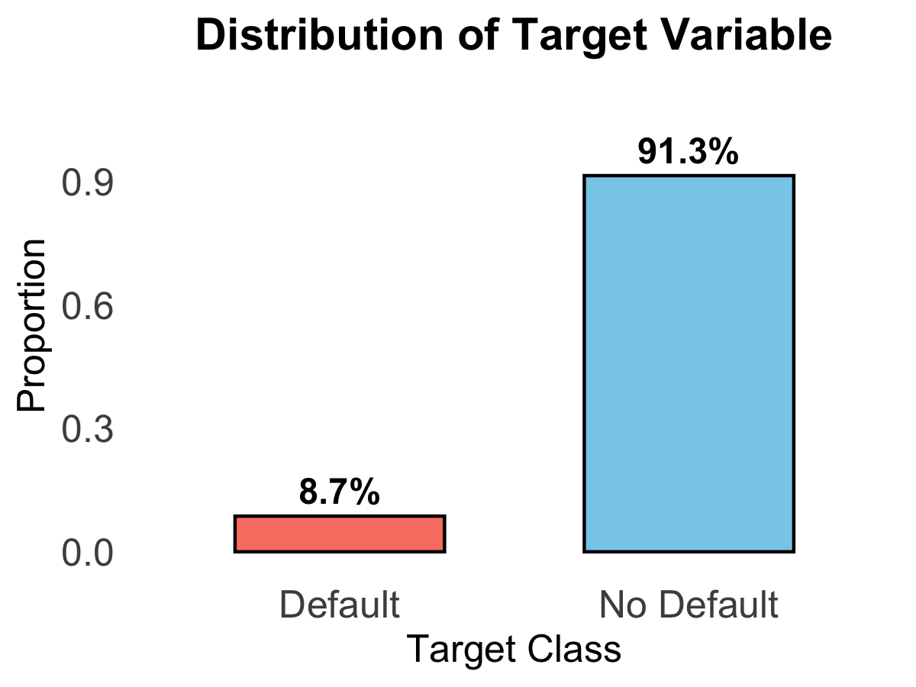
Data Cleaning & Preprocessing
Missing Data
Outliers
Data Distribution
Feature Engineering
Notes:
Preparing the data for modeling required addressing some key issues,
Missing data : 45 variables were missing over 48% of the data
- The other variables were only missing up to 20% of the data and were imputed
There exists a significant imbalance in the dataset with respect to the target variable
- ( 91.33 percent of the data being those who did not default)
There were outliers and data issues:
- Income over 2 million
- Children over 15
- The days employed had many error values of 365243 – those were discarded
We also engineered additional features to capture more complex relationships
- The standouts here were:
o Missing external 1-3
o Missing all
o Credit duration where credit over annuity, which would reflect the approximate periods required to pay off total credit (higher value may indicate more issues with repayment)
Missing values in all three sources (All_EXT_Missing = 1) are associated with slightly higher average income and older age (Avg_Age = 42.75).
This suggests that missing external scores might not solely indicate financial exclusion, but potentially unique financial behaviors or reporting differences.
there are 128 defaulters who have NA values across all the external sources

Slide 8
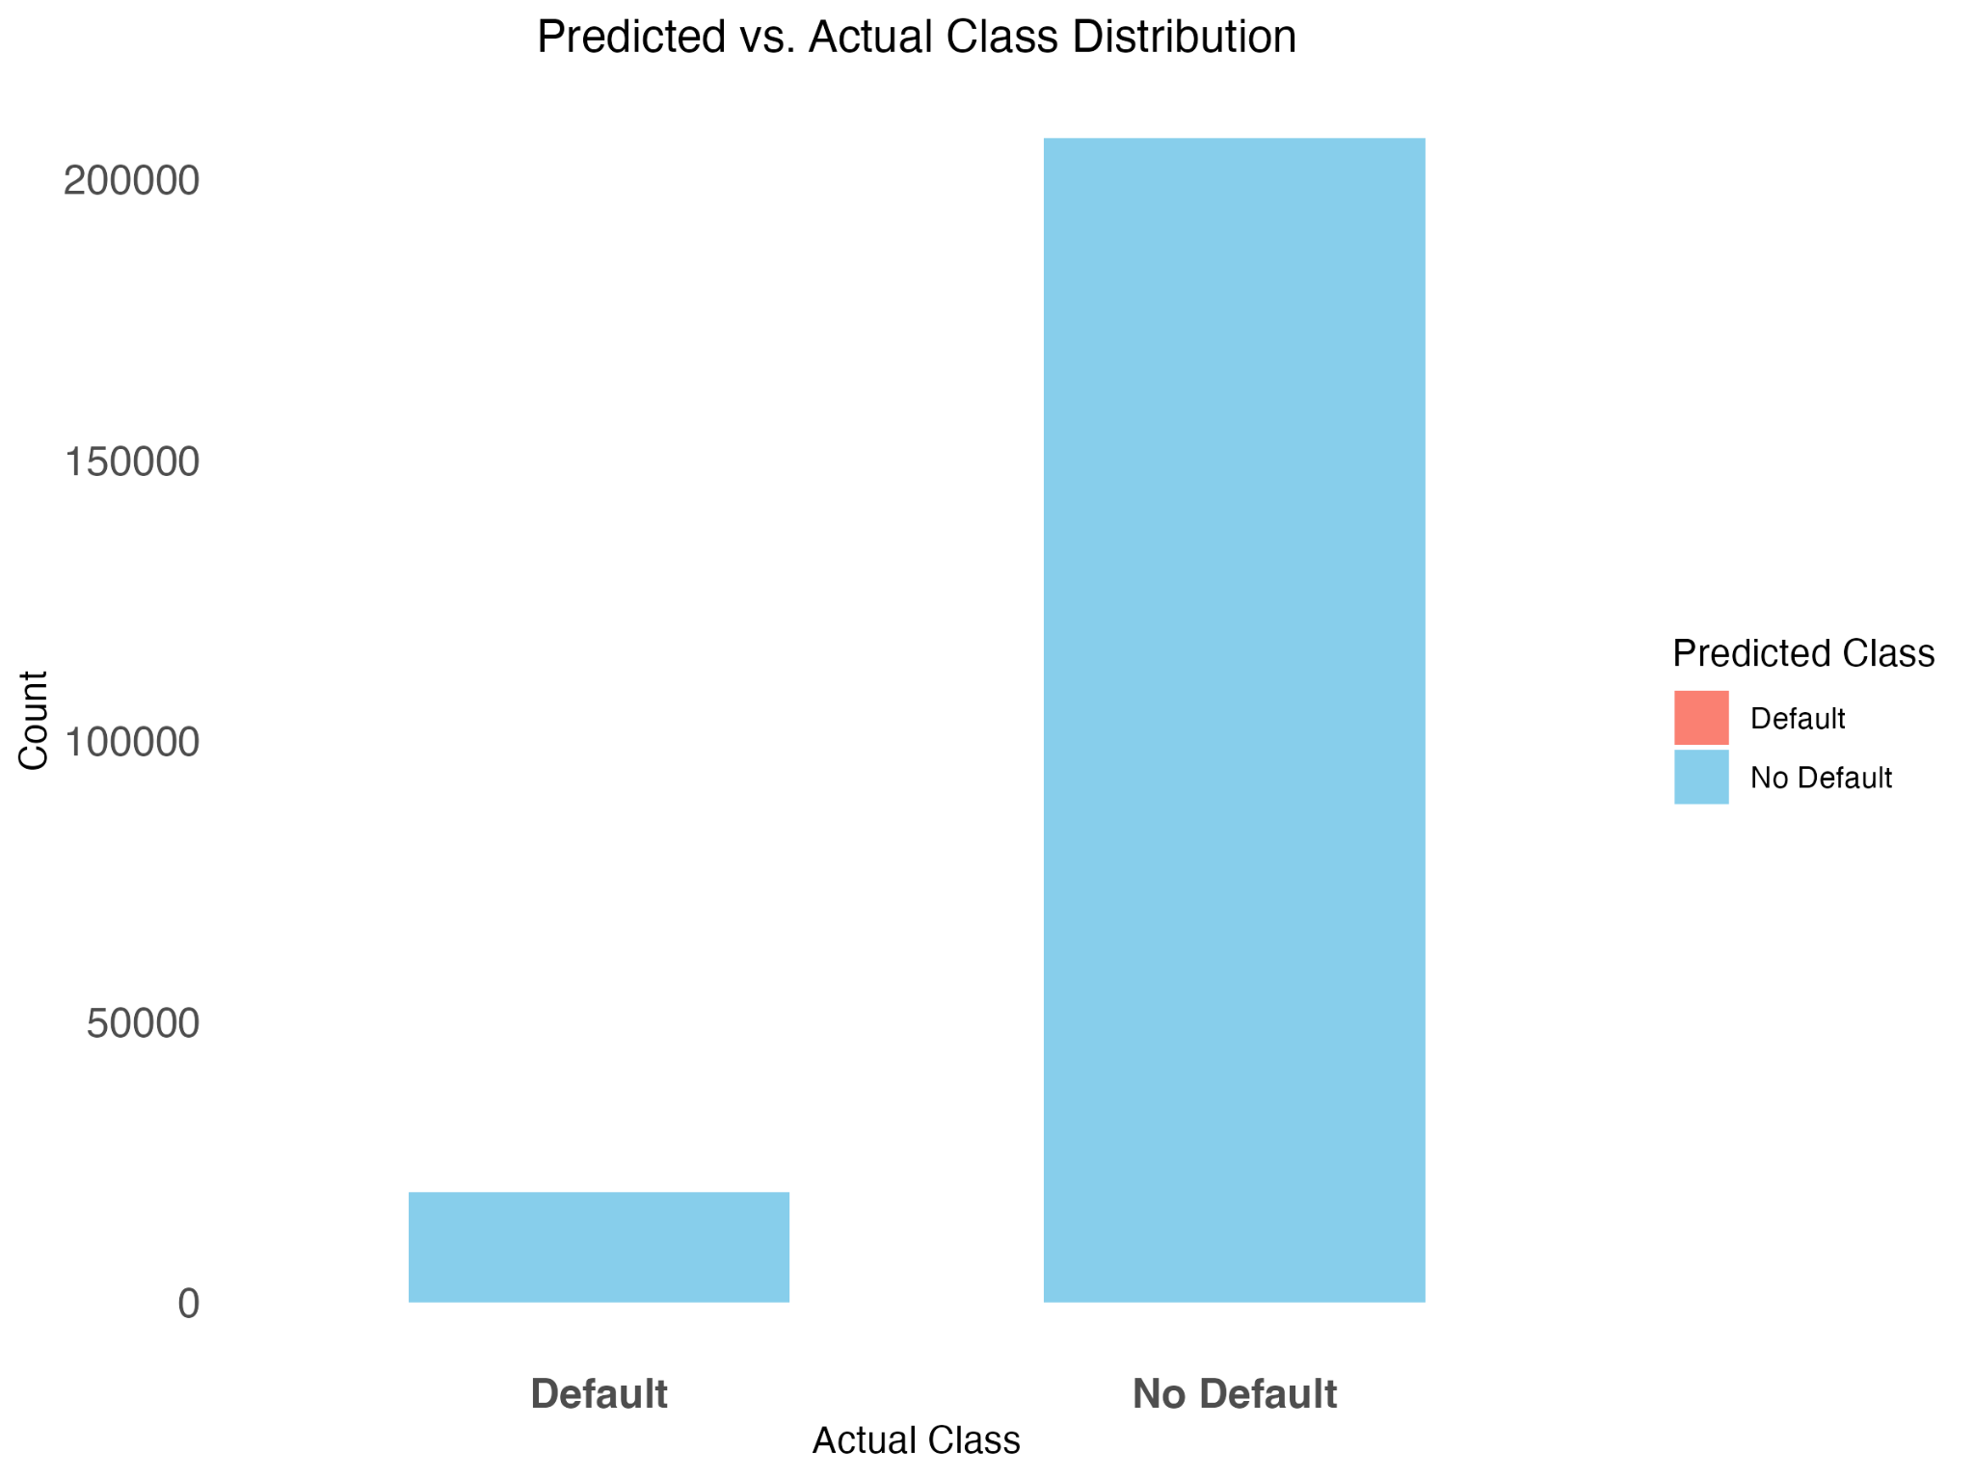
Notes:
Moving into modeling, we started with with establishing baseline model performance with the majority classifier: SLIDE 9
This baseline helped us see that while accuracy appeared high at over 91%, it completely failed to identify defaults, achieving a recall of zero. This highlighted how accuracy alone was not a robust enough metric – this model scored a 0.5 AUC.

Slide 9
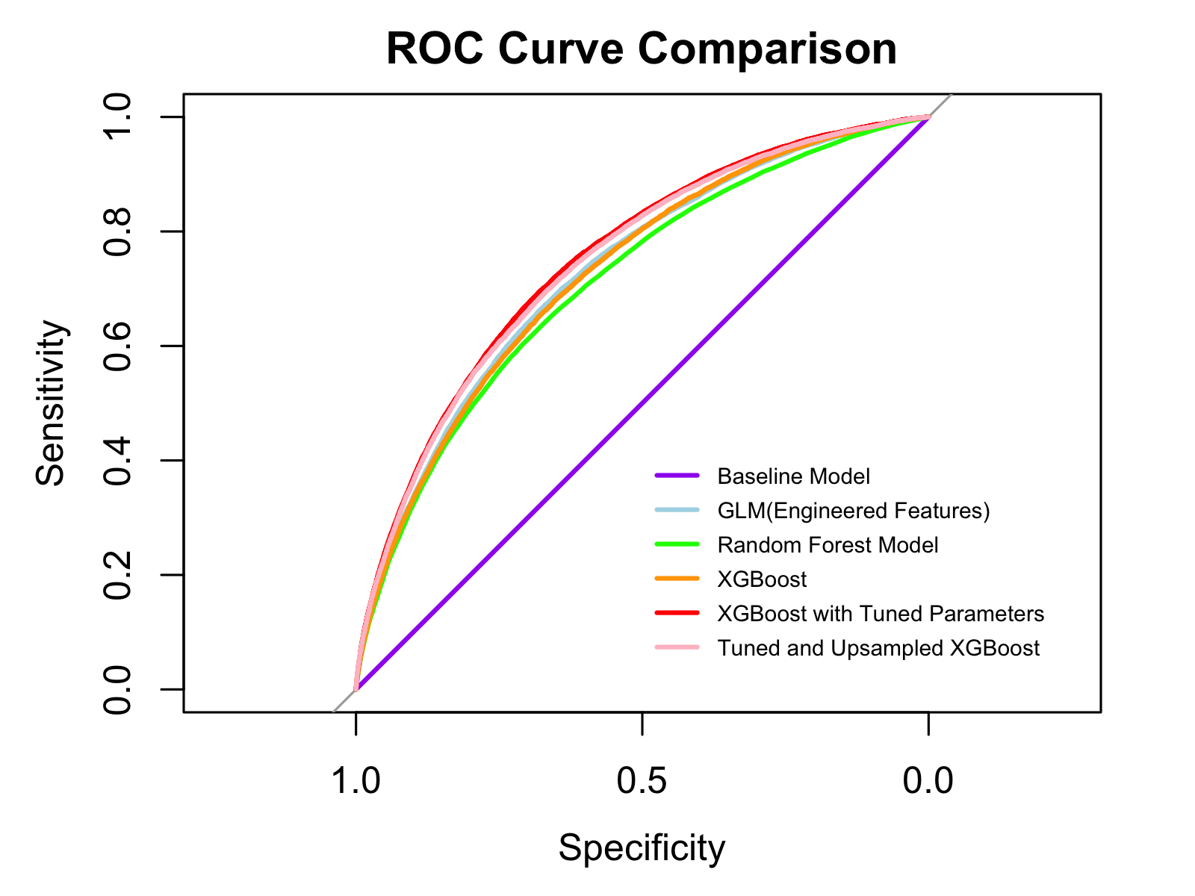
Notes:
We moved on to modeling with the engineered features and randomforest, and worked with some XGBoost models.
To address these issues, we implemented an XGBoost model, which is well-suited for tabular data and classification problems.
On the original, imbalanced dataset, XGBoost delivered a solid AUC score of 0.751, demonstrating strong ranking ability.

Slide 10
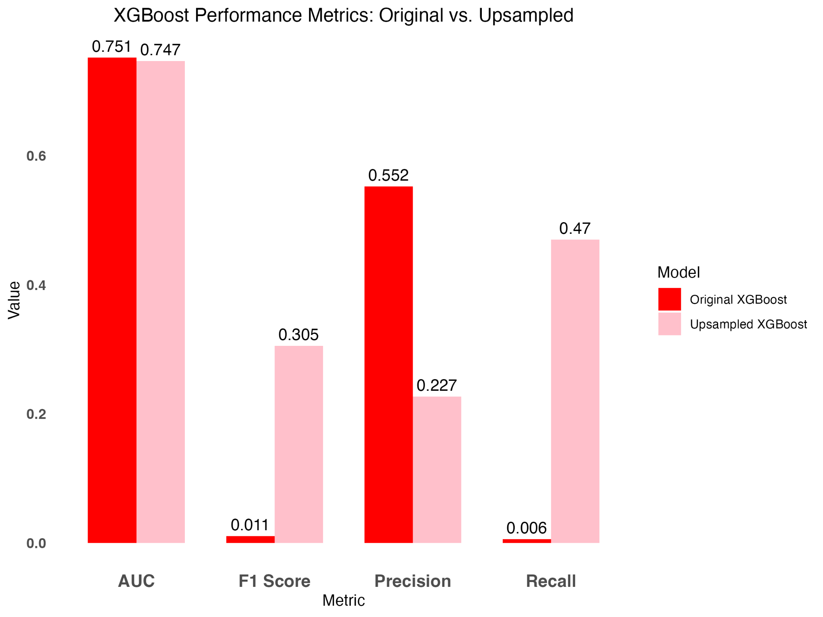
Notes:
However, its confusion matrix revealed super low sensitivity in predicting instances of defaulting at of only 0.6%, meaning it still struggled to identify the minority class effectively.
Recognizing the need to prioritize recall, we applied upsampling to balance the dataset.
This allowed the model to see more default cases during training, and the results were significant.
The upsampled XGBoost model improved recall dramatically, from 0.6% to 47%. While precision decreased this trade-off was intentional to ensure we captured as many defaults as possible, minimizing false negatives. As it would be more costly for us to have an applicant default than it would be to have the applicant apply again.
The F1 score—a balance of precision and recall—also improved from 0.011 to 0.305, showing a more meaningful overall performance.

Slide 11
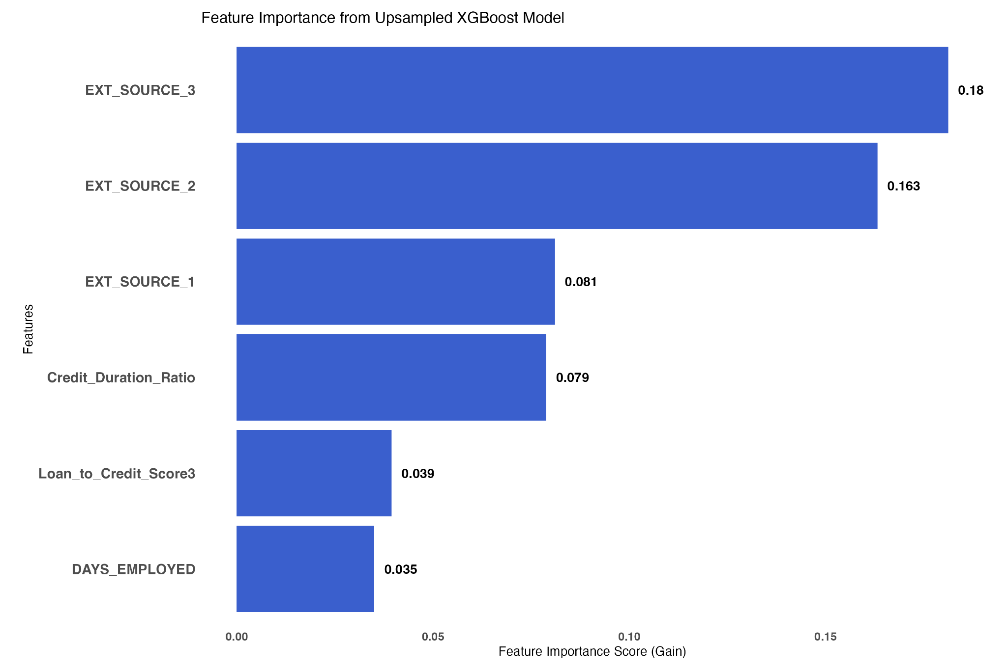
Notes:
Feature importance analysis from the XGBoost model further highlighted the top predictors of loan defaults, giving us actionable insights that can be used for targeted interventions.
Which included the external credit scores for the individuals, as well as our own engineered feature for credit duration which was credit/annuity : higher ratio suggests longer repayment terms, which could be riskier

Slide 12


0.74268
0.74569
Notes:
Our XGBoost model with tuned parameters on upsampled data resulted in these Kaggle scores

Slide 13
Challenges
Low Specificity
Despite achieving high accuracy, models struggled with effectively identify defaulters
Class Imbalance
92% non-defaulters
Data Quality
Missing values and extreme outliers
Notes:
Key Findings
Madalyn
Baseline Analysis (Tasks 1 & 2):
The dataset showed a significant class imbalance with around 92% of applicants being non-defaulters (TARGET = 0).
A simple logistic regression model predicting the majority class (non-defaulters) achieved an accuracy of approximately 91.9%, which became the baseline.
Logistic Regression (Tasks 3 & 8):
Initial logistic regression models using selected predictors (like age, income, credit amounts, and external sources) performed reasonably well with high accuracy but low specificity.
Feature engineering, including interaction terms (e.g., Age * Income) and newly created variables (like Debt-to-Income Ratio), improved model performance slightly:
Final logistic regression with feature engineering achieved an accuracy of 92.7%.
Despite improvements, specificity remained low, making it challenging to detect defaulters.
Random Forest (Task 4):
Random forests showed high sensitivity but suffered from poor specificity, indicating difficulty in identifying default cases accurately.
Feature importance analysis identified predictors like EXT_SOURCE_2, EXT_SOURCE_3, DAYS_EMPLOYED, and DAYS_BIRTH as critical features for predicting defaults.
Adjusting the model to include only the top features improved accuracy but still did not significantly enhance the ability to detect defaults.
Support Vector Machines (Task 5):
SVM models struggled with the imbalanced dataset, achieving near-perfect sensitivity but very low specificity.
Feature scaling and dummy encoding were implemented, and hyperparameter tuning (using radial basis functions) was conducted.
The best SVM model achieved an accuracy of 93.6% but had almost zero specificity.
Upsampling to Address Imbalance (Task 6):
Upsampling techniques were applied to balance the classes, which improved the sensitivity of the models.
However, the models still showed poor performance in identifying defaulters, with specificity remaining below 4% even after upsampling.
Ensemble Modeling (Task 7):
Combining predictions from logistic regression and random forest models into an ensemble model yielded a slight accuracy improvement to 92.9%.
Like other models, the ensemble model maintained high sensitivity but struggled with specificity, failing to effectively identify defaulters.
Data Cleaning and Feature Engineering Updates (Task 8):
Further cleaning efforts were conducted to handle missing values, extreme outliers (e.g., implausible DAYS_EMPLOYED values), and data inconsistencies.
Additional feature engineering, such as binning variables (e.g., Age and Income) and creating interaction terms, slightly improved model performance.
The updated logistic regression model with engineered features achieved a slightly better AUC and specificity compared to earlier models, but the gains were modest.
Challenges and Limitations
Class Imbalance: The significant class imbalance in the dataset (92% non-defaulters) made it difficult for models to effectively detect defaulters.
Low Specificity: While sensitivity was consistently high across models, specificity remained very low, indicating that models struggled to identify true positives (defaulters).
Data Quality Issues: Missing values, extreme outliers, and implausible data points (e.g., extreme employment lengths) complicated the analysis and required extensive data cleaning.
Recommendations
Further Feature Engineering:
Explore additional external datasets or domain-specific features to enhance the model's ability to differentiate between defaulters and non-defaulters.
Consider non-linear transformations, polynomial features, or deep learning models that can capture complex relationships in the data.
Handling Class Imbalance:
Explore advanced techniques like SMOTE (Synthetic Minority Over-sampling Technique) or cost-sensitive learning to better handle the class imbalance.
Adjust decision thresholds to optimize the balance between sensitivity and specificity.
Model Interpretability:
Focus on improving the interpretability of models to understand which features most influence predictions. Techniques like SHAP (SHapley Additive exPlanations) can be useful.
Benchmarking Against Kaggle Scores:
To better understand the performance relative to others, benchmarking the models against the Kaggle competition leaderboard would provide insights into where the current models stand.
This summary serves as a high-level overview of the modeling efforts and outcomes. Further refinement and exploration are required to achieve a robust model capable of accurately predicting credit defaults.

Slide 14
Improvements
Enhance Feature Engineering
Refine Data Cleaning
Notes:
Enhance Feature Engineering
Interaction Terms
Credit-to-Income Ratio, Age and External Scores Interaction, Debt-to-Income Ratio × Age, Employment Length × Income, Children Count × Income
Binning Continuous Variables
Age Binning, Income Binning, Credit Amount Binning, and Employment Length Binning
Leverage Additional Datasets
Refine Data Cleaning
Address additional outliers

Slide 15

Empowering people to live the life they want now.
Notes:
Summary of Findings - Modeling Group Project 2.0
misclassify 3.25% of applicants, which is a 5.41% reduction from the majority classifier allowing Home Credit to approve more applicants with our model. -> allows us to reduce the false negatives by 59.4% and be more confident in the loans they are lending
Type 1 error: false positive
Type 2 error: false negative
Really messy data
Lots of missing variables
Models computational run time was not significant
Bring in bureau data in future iterations -> saw significance with a real debt to income
*Rough Idea* The models effectively identified non-defaulters but struggled with correctly classifying defaults, leading to low specificity. Future work will focus on integrating additional data sources and optimizing models for better real-world performance.

